Slide 1
Discovering Agendas in DOJ Press Releases
Unstructured Data Analytics for Policy
Spring 2019
Elizabeth Speigle
Antonio Lodico
Jared Kohler
Kaila Gilbert
Bonnie Fan

Slide 2

United States Department of Justice
Responsible for the enforcement of the law and administration of justice.
Divisions - Antitrust, Civil, Civil Rights, Criminal, Environment and Natural Resources, Justice Mgmt, National Security, Tax
Administers FBI, ATF, DEA
Runs federal prison system
Reviews local law enforcement conduct

Slide 3
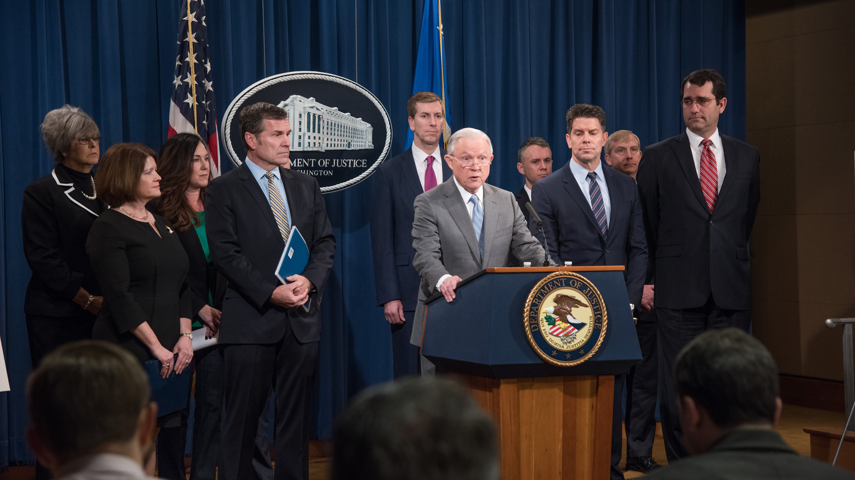
Research Question:
What are the “expressed” agendas associated with each attorney general?
Notes:
AG
Head of the DOJ (also top lawyer of US govt)
In existence since Judiciary Act of 1789 (predating the DoJ by 81 years)
President nominates, Senate approves
85 in our history (+ 10 acting only)
Current AG : William Barr (also AG under Bush 1)
Last AG in our data : Jeff Sessions
3 AGs acting under Trump
Obama had 2, 3 if counting acting

Slide 4
Policy Relevance
Congress - Review and oversight of Attorney Generals
Lawyers - FOIA lawsuits, Class-action suits
Policy Experts - Memos, reports, etc. citation
Media - “A study by CMU grad students shows…”

Slide 5
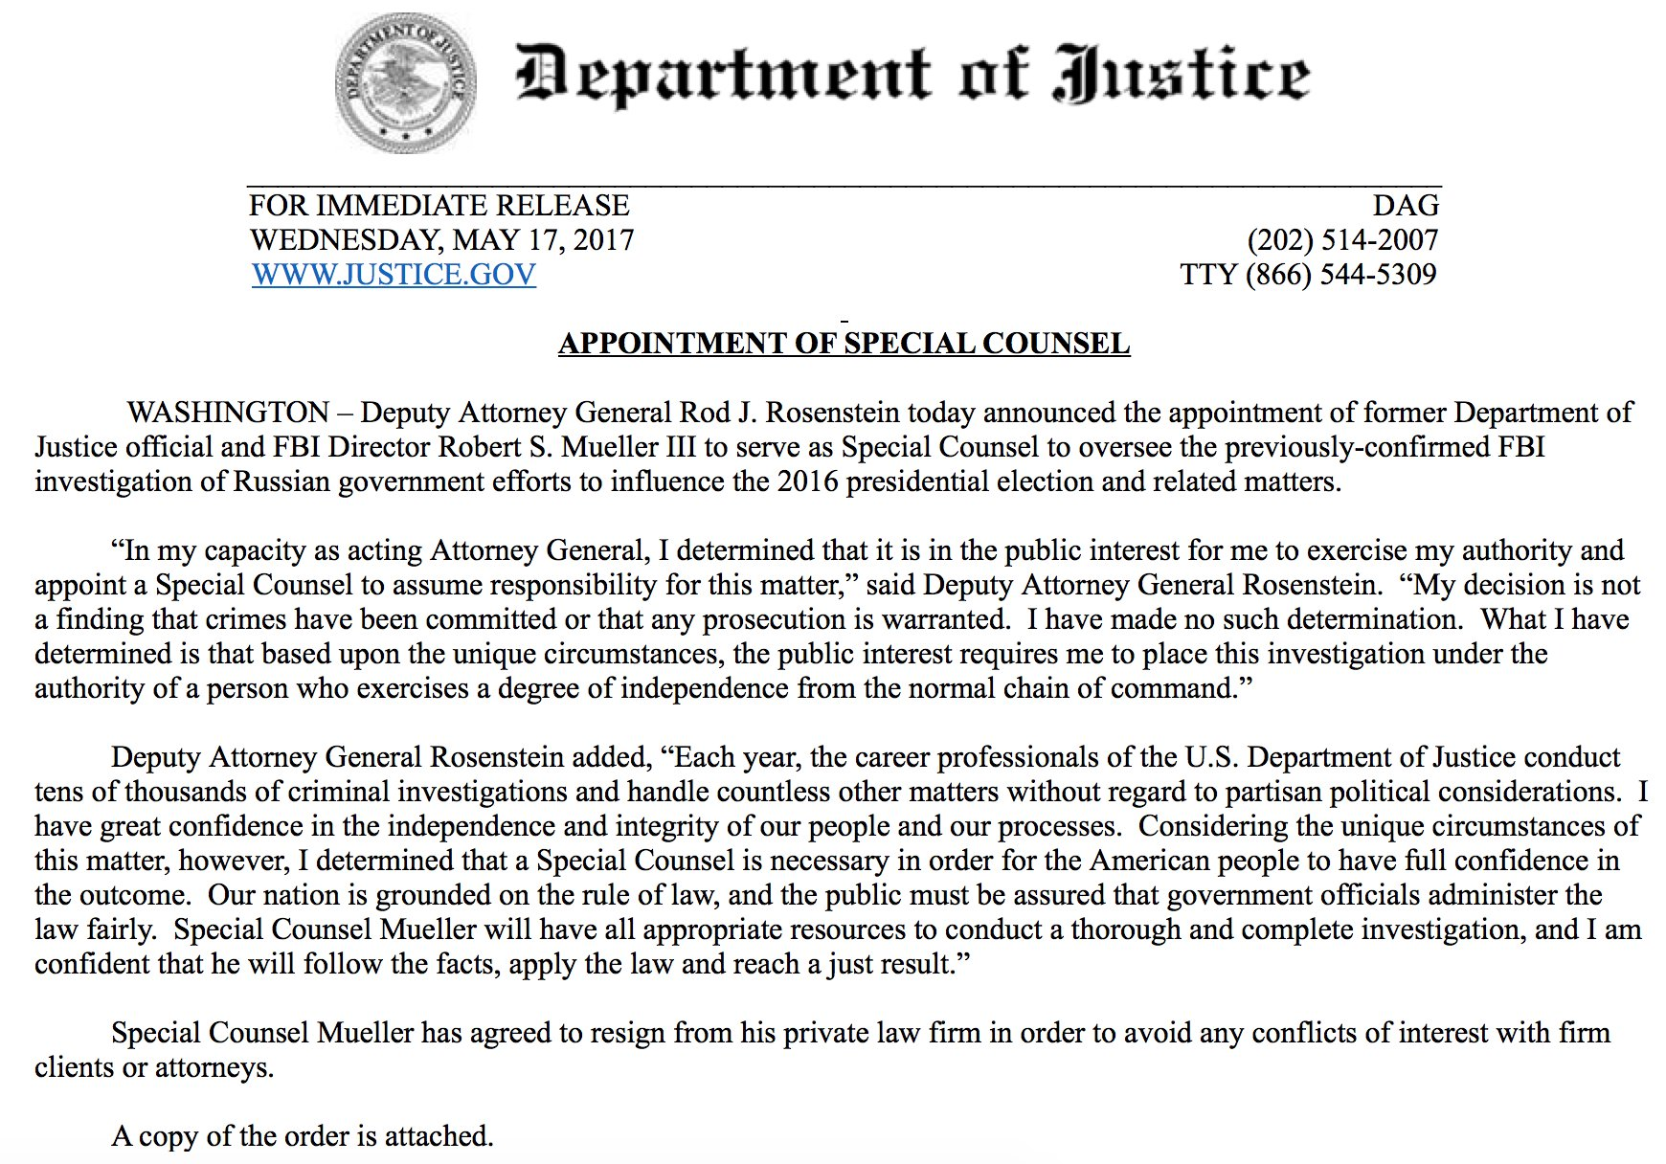

Slide 6
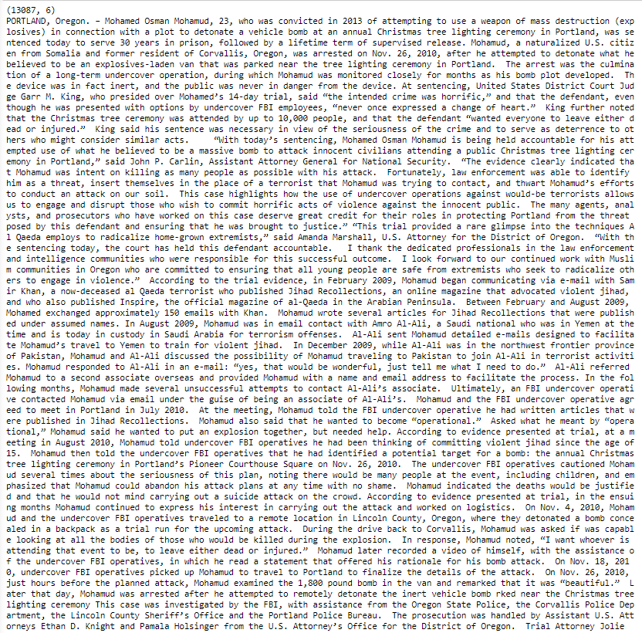
Data
13,000 DOJ press releases
2009 - Present
Sources: Kaggle, justice.gov/news
JSON file - 57 MB
Data types: dates, text (unstructured)

Slide 7
Methodology
Import, Process, Transform – JSON, NumPy, Pandas
Feature Extraction – CountVectorizer
Clustering / Topic Modeling – LDA
Dimensionality Reduction – t-SNE
Topic Scores by Division
Visualization – Matplotlib

Slide 8
Topic Modeling

Slide 9
financial
criminal
bank
enforcement
fraud
accounts
money
case
sexual
criminal
pornography
children
victim
fraud
medicare
health
care
services
hhs
environment
epa
air
water
natural
oil
resources
criminal
guilty
office
general
case
pleaded
trial
united
states
security
national
fbi
district
tax
irs
returns
income
false
federal
court
claims
health
civil
settlement
government
general
rights
civil
federal
law
housing
discrimination
enforcement
prison
sentence
indictment
conspiracy
police
gang

Slide 10
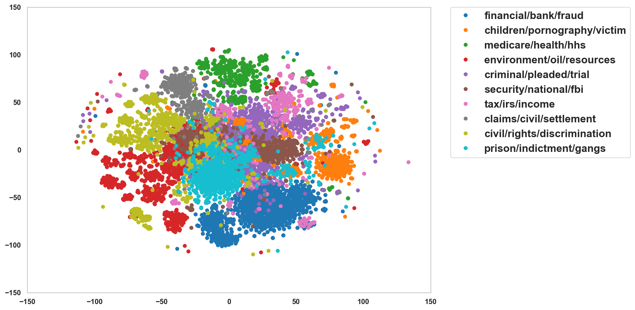
Clustering Topics with t-SNE

Slide 11
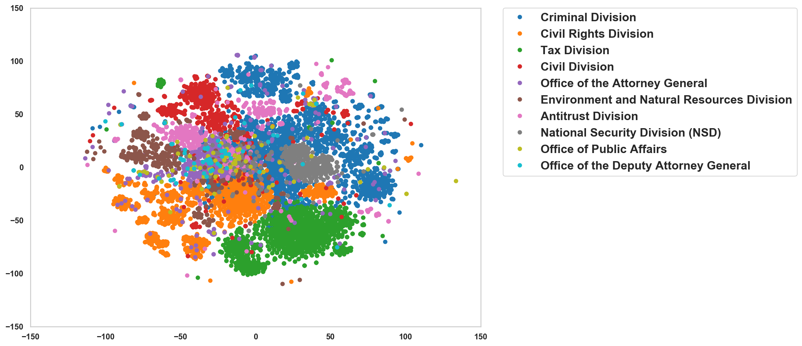
Clustering by Division
Overlapping clusters but important differences between topic and division
Notes:
Tax division clearly matches topic 6
National Security Division matches topic 5
Environment & Natural Resources matches topic 3
Civil Divison matches topic 7
Civil Rights Division matches topic 8, also some of 9 and 1
Criminal Division encompasses several topics: 0, 1, 2, 4

Slide 12
Topic Differences By Attorney General

Slide 13
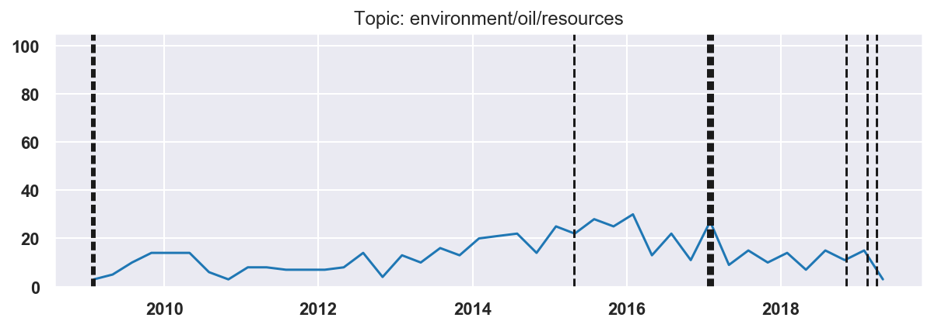
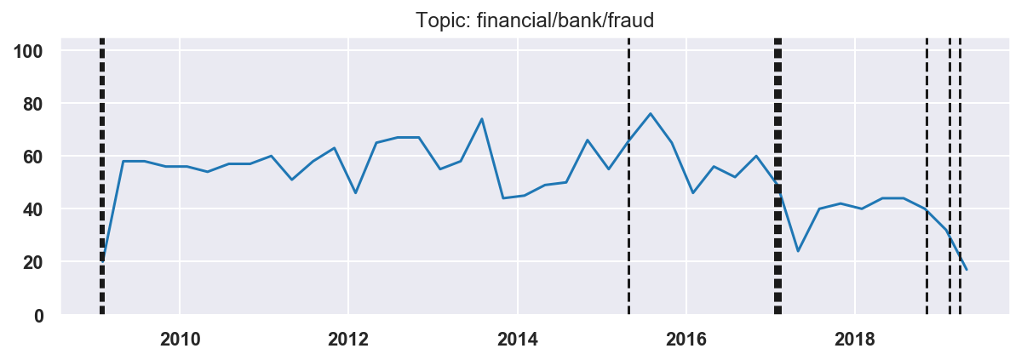
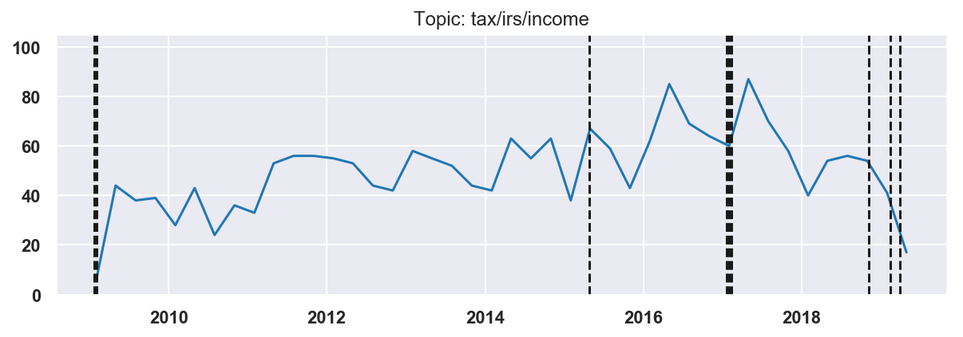
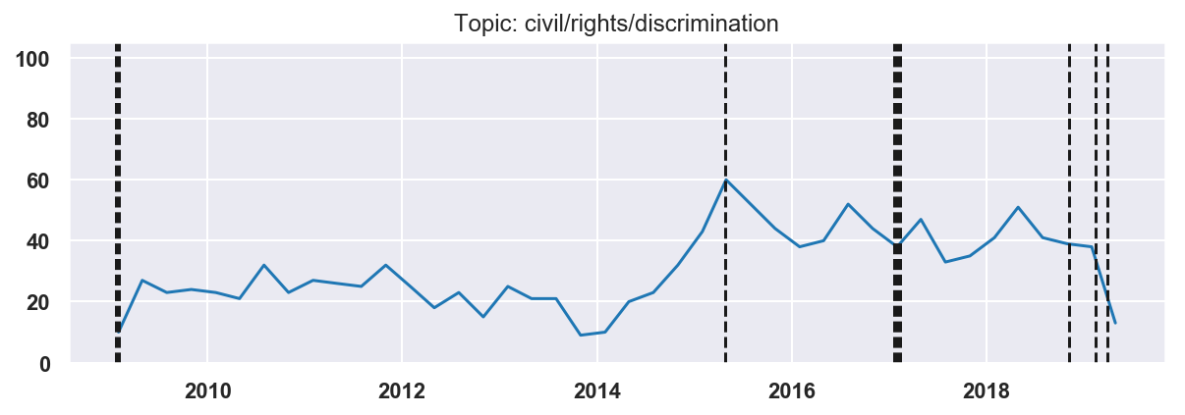
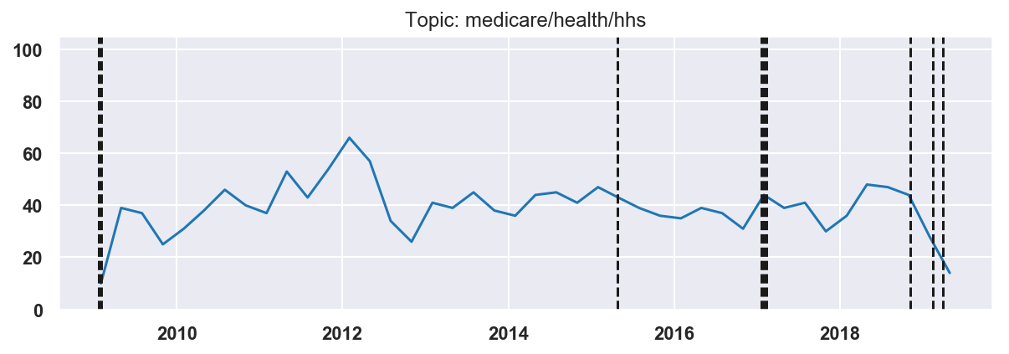
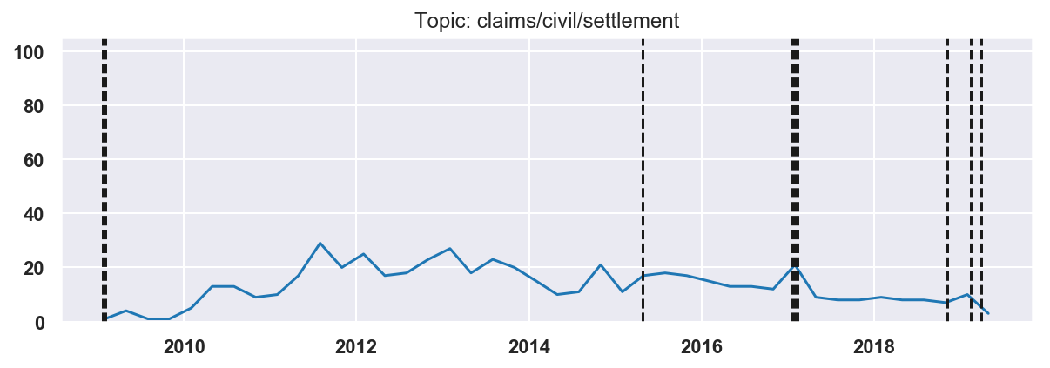

Slide 14
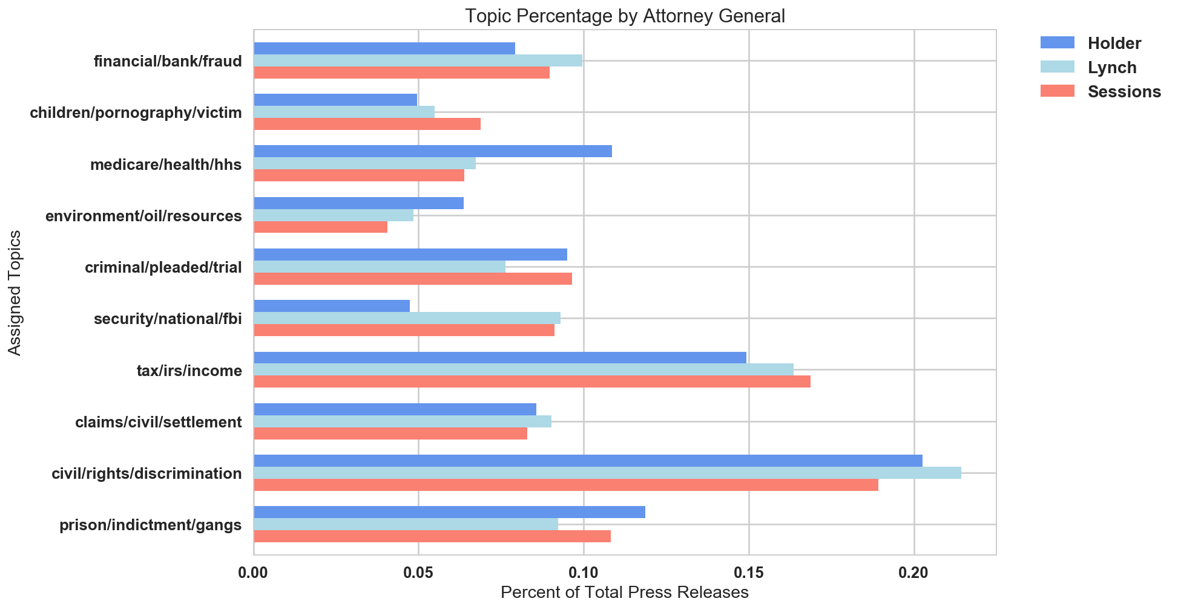
Topic Frequency by Attorney General

Slide 15
Topic Scorings by Division

Slide 16
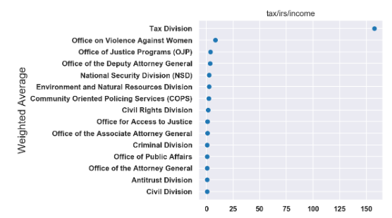
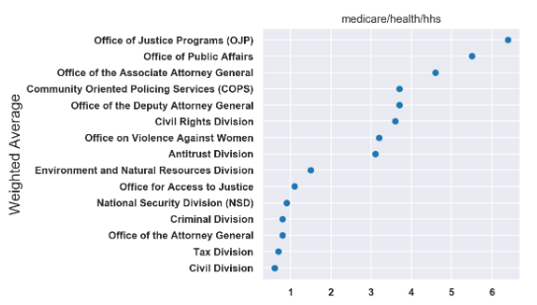
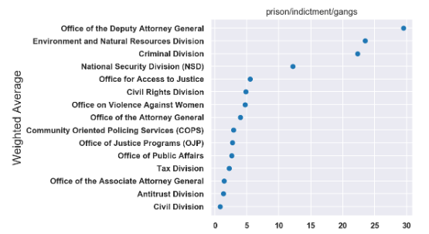
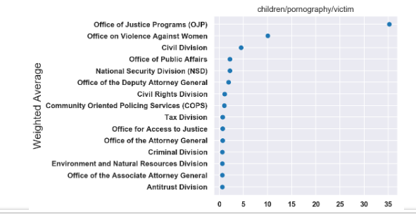
Topic Scores by Division

Slide 17
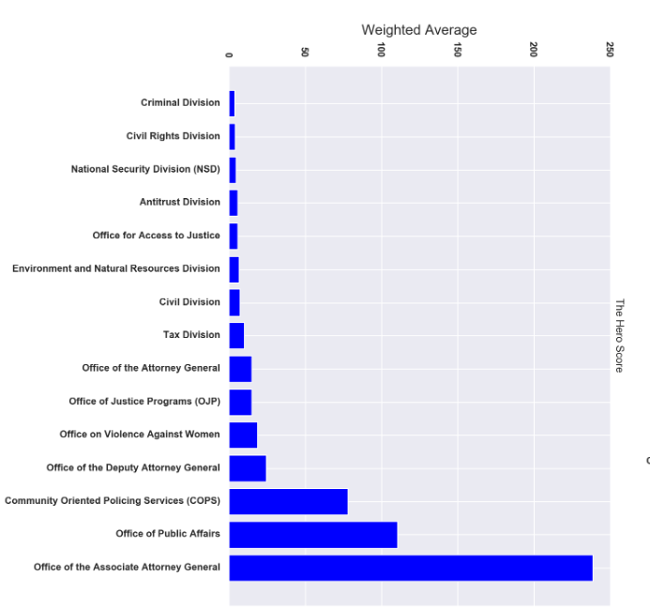
What values do we care about?
The “Hero Score” weights across topics with more humanitarian impact

Slide 18
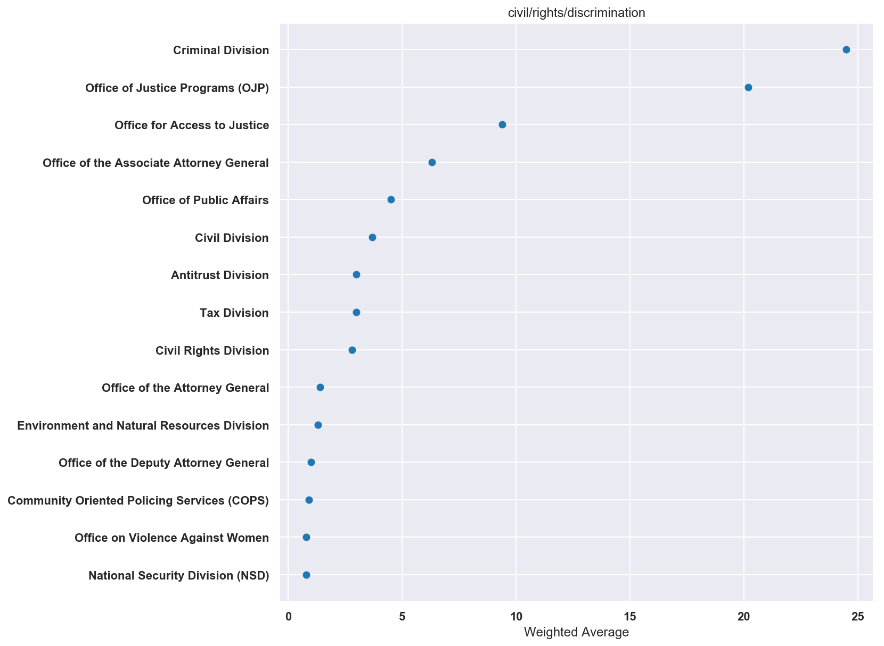
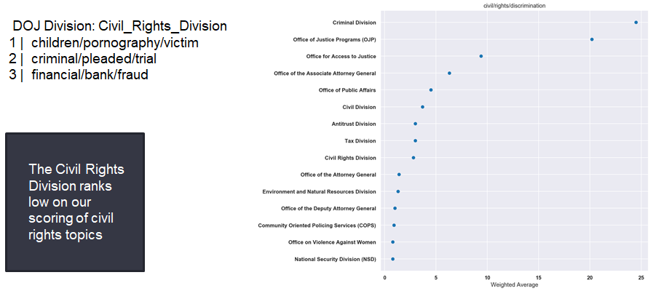
Department Agendas: Civil Rights

Slide 19
Topics/Agendas in the
Civil Rights Division

Slide 20
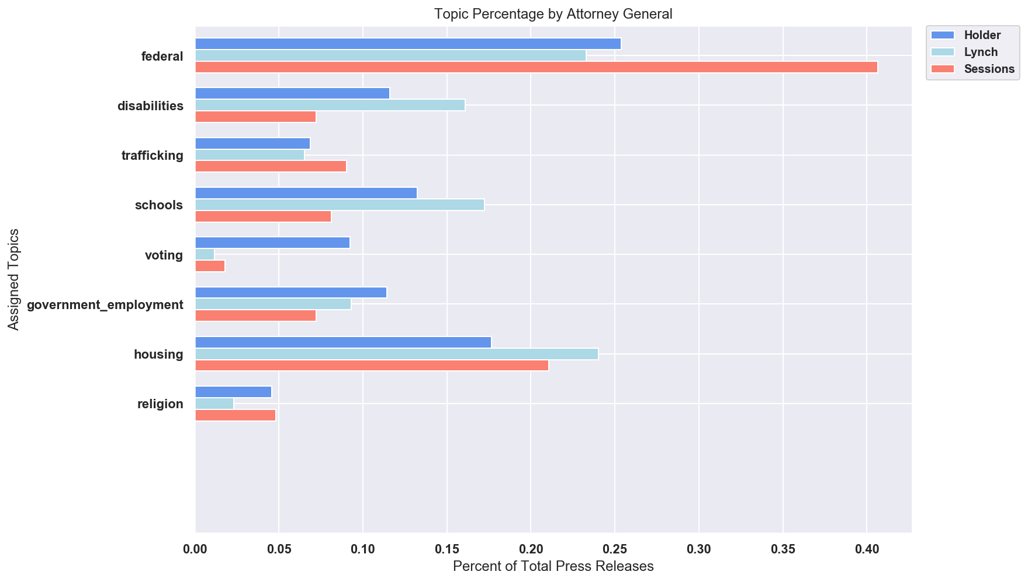
Civil Rights Agendas by Attorney General
Topics within Civil Rights Division
Very noticeable drop on voting cases and disabilities

Slide 21
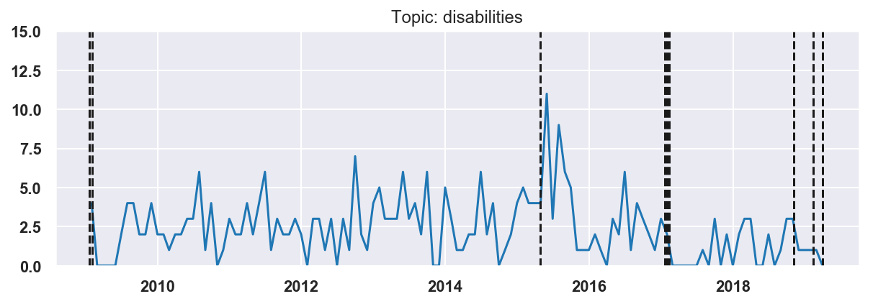
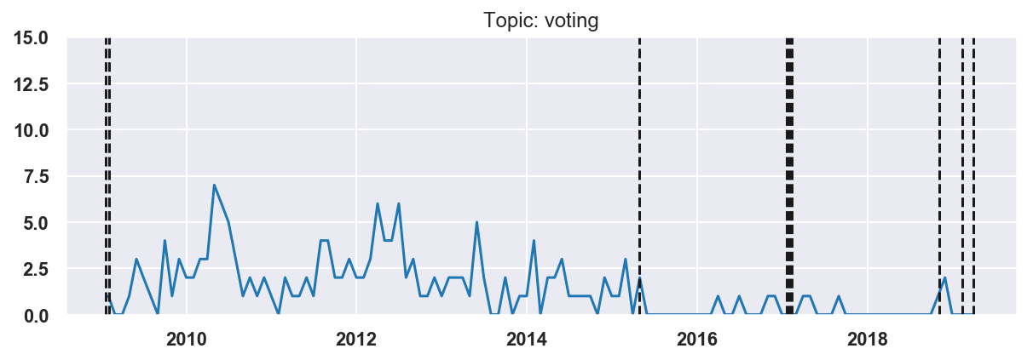
Civil Rights Agendas: Biggest Changes
Very noticeable drop on voting cases and disabilities

Slide 22
Conclusions

Slide 23
Future Extensions
Wider range of dates: include pre-Obama years
Topic modeling within other divisions: Anti-trust, Criminal, National Security
Other text analysis: bi-grams, co-occuring words, post-processing to remove common words between topics
Notes:
Future: Current dataset is imbalanced - 80% of press releases were in Democratic administration; more data prior to Obama administration would be interesting
Within-department topic modeling (eg topics for only civil rights division, environment division)

Slide 24
Findings
Topics are aligned with DOJ divisions
Clear changes in agendas by attorney generals at the division level
Voting and disability cases not prioritized by last two AG’s
Notes:
Changes in topics: more tax, more national security, less civil rights, less environment/natural resources under republicans (started under Lynch)

Slide 25
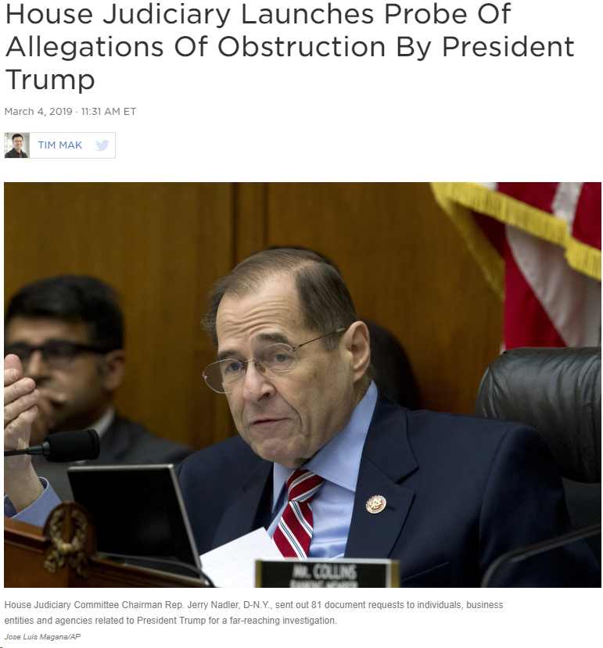
Recommendations
Share findings with the House Judiciary:
Civil Rights Subcommittee
The investigation into threats against rule of law & judiciary misuse by President
Communicate results to other stakeholders and public at large:
For policy documents
Increase “sunlight” on DOJ
Notes:
Recommendations - Nadler

Slide 26
Questions?

Slide 27
APPENDIX

Slide 28
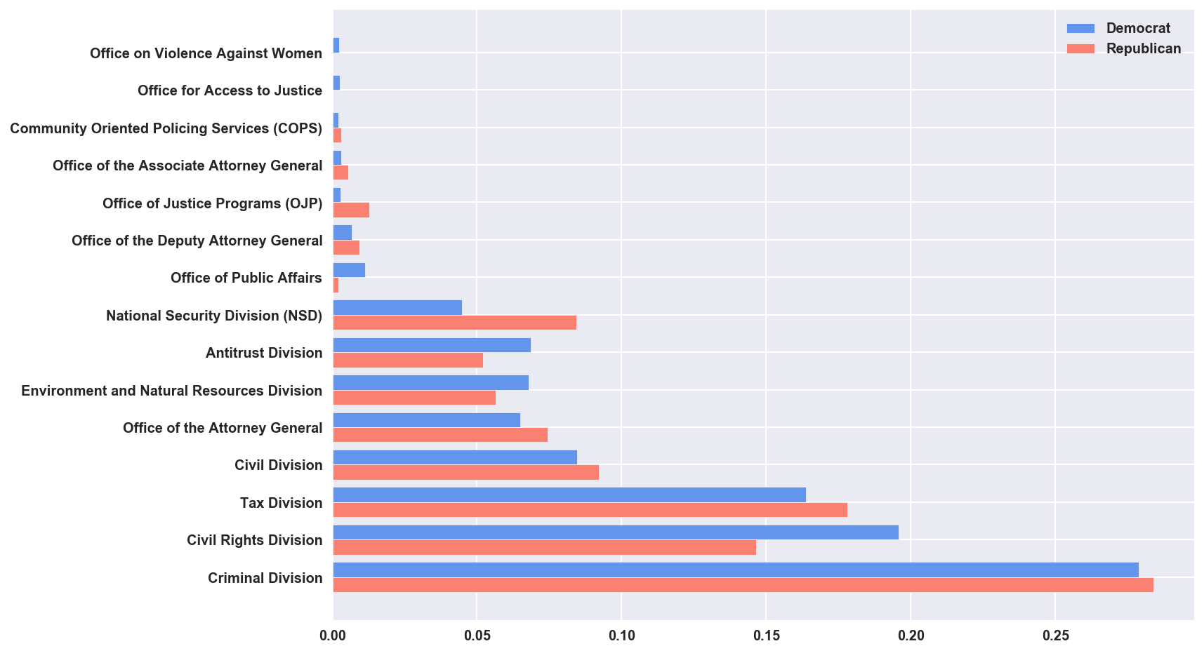
Proportion of Documents by Division for each Party
Notes:
Maybe we don’t need both

Slide 29
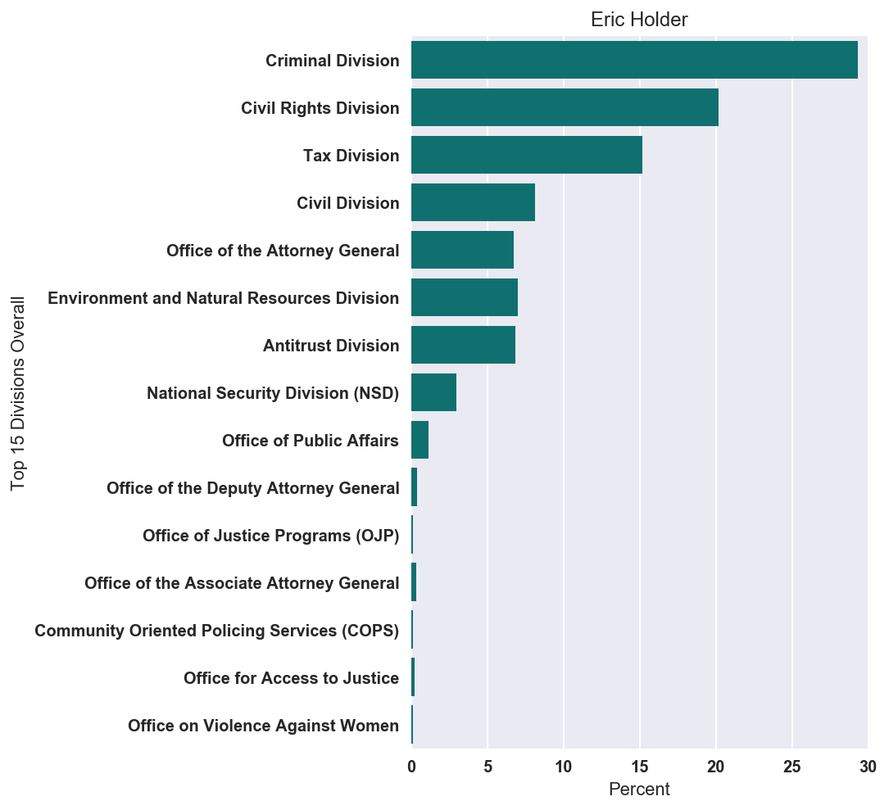
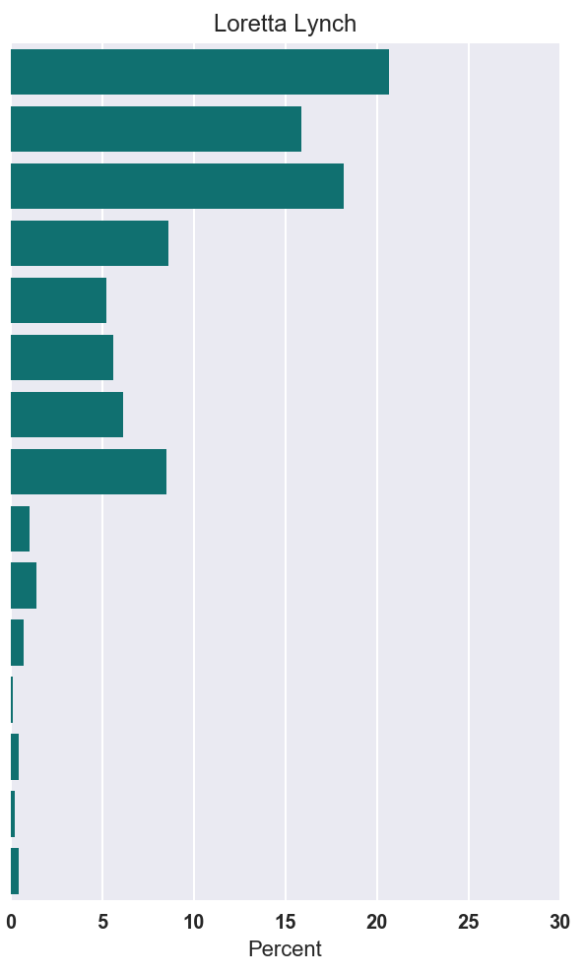
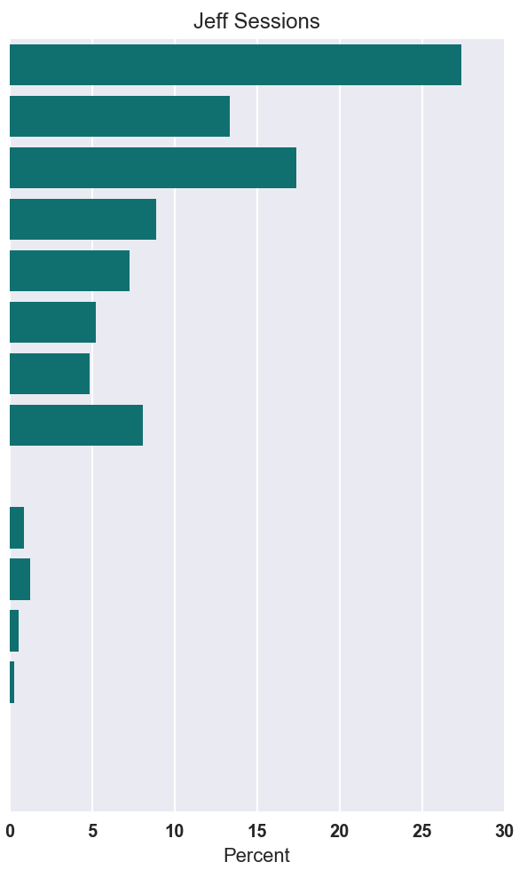
Documents by Division for AGs

Slide 30
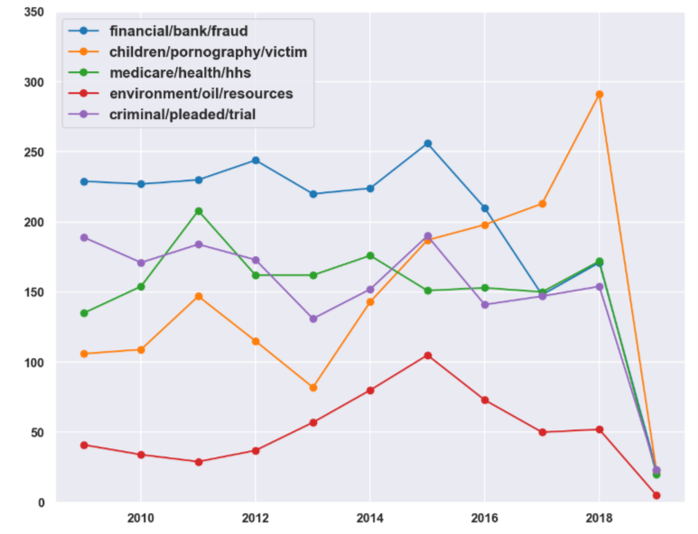
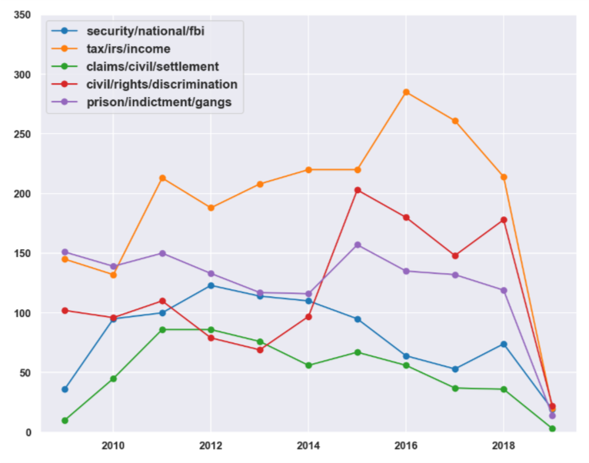
Topic Frequency by Year

Slide 31
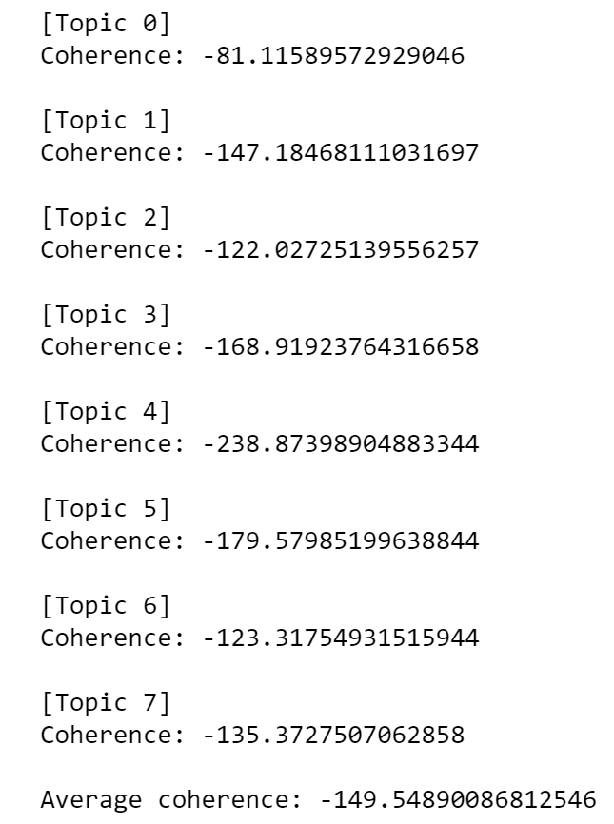
Civil Rights Topics
Topic 0
fbi 0.010857463774348349
district 0.010218303902952735
indictment 0.009710031308910596
federal 0.009097313909087862
case 0.008966935718292416
guilty 0.008874739267942168
officers 0.00871960242908898
law 0.008613053205181935
victim 0.00850439386907813
trial 0.008242676157755088
Topic 1
ada 0.015138369968297562
agreement 0.012928592725238964
access 0.010156679568096502
services 0.009843924520367187
state 0.009061008882530905
county 0.00826132059536355
disabilities 0.00823762075520768
settlement 0.008082191387080787
health 0.008035563493616699
court 0.007216636913167561
Topic 2
trafficking 0.02111443815232064
victims 0.015728512060134998
sex 0.012716448884150525
human 0.012554863254595882
defendants 0.011308964751367823
women 0.010307305920963279
case 0.008590705676952748
district 0.00817458948092629
states 0.007212978119711155
united 0.007140564117723845
Topic 3
district 0.014049346825346679
title 0.0095834756494544
school 0.00930326278649211
discrimination 0.00873658146589377
students 0.008550573332514182
police 0.008367247578048477
agreement 0.007290857099198252
court 0.006940885875299748
city 0.006622962743834453
law 0.006482507733543505
Topic 4
voting 0.022795056247896756
federal 0.019288724275036605
act 0.011418910267454976
election 0.010595072328492118
african 0.00936708123705389
cross 0.008057106835727912
today 0.007394547252404014
monitor 0.007030501010426957
activities 0.006919575188256722
polling 0.006890974707297541
Topic 5
ada 0.01777934333948755
service 0.01610210403956676
disabilities 0.014075997829913473
userra 0.011274176673569126
military 0.010385227502730193
employment 0.010374560546400218
services 0.008803006665239938
www 0.008418577066194415
agreement 0.008193837416064536
gov 0.008097523887842352
Topic 6
housing 0.02499076739476205
discrimination 0.02191256043329518
fair 0.01176350829983794
800 0.01098533590158151
act 0.01023943276505681
gov 0.009047365930452767
settlement 0.007486975067923533
employment 0.007420078080069355
status 0.0072106811944166365
immigration 0.006873420036175253
Topic 7
district 0.020144082735675754
court 0.013440494312904795
general 0.0128509022716543
law 0.0121911324845488
said 0.012011440220996993
county 0.010683429721363382
act 0.009787518522161075
religious 0.008856555341587597
enforcement 0.0088248930605822
voting 0.007736085263676403

Slide 32
General Topics
[Topic 0]
Coherence: -76.22678975210303
[Topic 1]
Coherence: -100.03474026577699
[Topic 2]
Coherence: -95.86929826175978
[Topic 3]
Coherence: -139.22230627345624
[Topic 4]
Coherence: -63.905449355057705
[Topic 5]
Coherence: -91.85295868442182
[Topic 6]
Coherence: -84.88526693820955
[Topic 7]
Coherence: -167.06915398135706
[Topic 8]
Coherence: -84.05924203605548
[Topic 9]
Coherence: -111.20337218906627
Average coherence: -101.4328577737264
topic_names = {
0 : 'financial/bank/fraud',
1 : 'children/pornography/victim',
2 : 'medicare/health/hhs',
3 : 'environment/oil/resources',
4 : 'criminal/pleaded/trial',
5 : 'security/national/fbi',
6 : 'tax/irs/income',
7 : 'claims/civil/settlement',
8 : 'civil/rights/discrimination',
9 : 'prison/indictment/gangs'
}

